Slide 1
SEMESTER 2 WEEK 6
Analysis of Variance “One–Way ANOVA”
Olmos Isakov & Gulomjon Kosimjonov
WIUT 2021

Slide 2
Lecture outline
Understanding ANOVA
Hypotheses testing using R
Manually filling missing parts in ANOVA table
Interpreting the results.

Slide 3
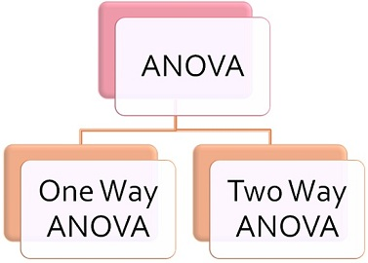
Analysis of Variance (ANOVA)
ANOVA is a statistical procedure used to test the degree to which two or more groups vary or differ in an experiment.

Slide 4
ONE - WAY ANOVA
One-Way ANOVA a type of statistical test that compares the variance in the group means within a sample whilst considering only one independent variable or factor.
This is an extension of the “t-test”
[that we studied last week],
but only with at least three levels!

Slide 5
BUSINESS APPLICATION
When you are interested in understanding the impact of:
Different types of promotions on sales
Different types of store layouts on sales
Different advertisement tactics on sales
Etc.
This is the exact type of analysis that ANOVA is built for.

Slide 6
CONDITIONS:
Each population from which a sample is taken is assumed to be normal.
All samples are randomly selected and independent.
The populations are assumed to have equal variances.
The factor is a categorical variable (factor).
The response is a numerical variable.

Slide 7
ONE WAY ANOVA TEST:
The ANOVA doesn’t test that one mean is less (more) than another,
only whether they’re all equal or at least one is different.
H₀: µ₁ = µ₂ = …. = µ_{n}
H_{a}: At least one mean score is different.
Rejection Region:
Reject H₀ if F_{stat} ≥ F_{crit}
Reject H0 if p-value < significance level

Slide 8
SCENARIO:
Based on the below given data, let’s assess whether crop yield differs depending on the type of fertilizer at 5% significance level
type1 | 177.23 | 177.55 | 176.41 | 177.70 | 177.13 | 176.78 | 176.75 | 177.06
 | 177.97 | 176.60 | 177.03 | 177.48 | 176.87 | 176.11 | 176.01 | 176.11
 | 177.26 | 176.92 | 176.24 | 176.57 | 176.04 | 176.82 | 176.16 | 177.23
 | 177.16 | 175.36 | 177.28 | 175.95 | 175.88 | 175.94 | 178.36 | 176.27
type2 | 176.48 | 176.04 | 177.41 | 177.36 | 177.39 | 176.98 | 177.38 | 178.00
 | 176.43 | 176.93 | 175.98 | 177.03 | 176.44 | 176.07 | 177.12 | 177.20
 | 176.60 | 177.21 | 177.15 | 176.82 | 177.00 | 178.13 | 176.43 | 176.67
 | 176.90 | 177.78 | 176.41 | 176.88 | 177.58 | 176.96 | 175.75 | 177.35
type3 | 177.10 | 178.08 | 176.90 | 177.54 | 177.03 | 178.29 | 176.41 | 176.43
 | 177.40 | 176.93 | 177.06 | 177.34 | 177.13 | 177.17 | 176.35 | 179.06
 | 176.30 | 177.59 | 177.12 | 177.79 | 177.00 | 178.04 | 177.70 | 177.63
 | 177.65 | 177.10 | 177.19 | 177.41 | 178.14 | 177.71 | 177.69 | 177.12

Slide 9

SOLUTION:
State the null and alternative hypotheses.
H₀: µ_{type1} = µ_{type2} = µ_{type3}
H_{a}: At least one mean is different
b. Run the ONE-WAY ANOVA test in R. Use α = 0.05.
[PLEASE REFER TO R FOR SOLUTIONS]
c. Provide your decision and conclusions.
Since p-value = 0.0007 < ⍺ = 0.05 we have sufficient evidence to reject H₀ and conclude crop yield differs with different type of fertilizers

Slide 10
DEGREE OF FREEDOM:
BETWEEN TREATMENT:
The between group, degree of freedom is one less than the number of treatments
We have three groups [type1, type2 and type3], so degree of freedom = k – 1 = 3-1 = 2
WITHIN TREATMENT:
The within treatment degree of freedom is the sum of the individual degree of freedoms of each group
The sample sizes are 32 for all three types, hence degree of freedom = n – k = 3*32 - 3= 93

Slide 11
SUM OF SQUARE VARIATION:
BETWEEN TREATMENT:
The variation between each sample mean and the grand mean
Each individual variation is weighted by the sample size
WITHIN TREATMENT:
The weighted total of the individual variations & the weighting is done with the degrees of freedom
The degree of freedom for each sample is one less than the sample size for that sample.

Slide 12
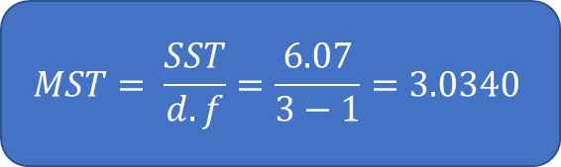
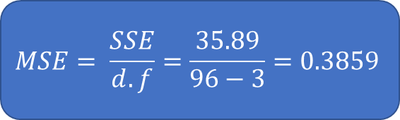
VARIANCES:
BETWEEN TREATMENT:
Mean of the Sum of Squares between Treatment - MST
Average squared deviation from the mean and are found by
dividing the variation by the degrees of freedom
WITHIN TREATMENT:
Mean of the Sum of Squares within Treatment - MSE
Average squared deviation from the mean and are found by
dividing the variation by the degrees of freedom
$$MST= \frac{SST}{d.f}=\frac{6.07}{3−1}=3.0340$$
$$MSE= \frac{SSE}{d.f}=\frac{35.89}{96−3}=0.3859$$

Slide 13
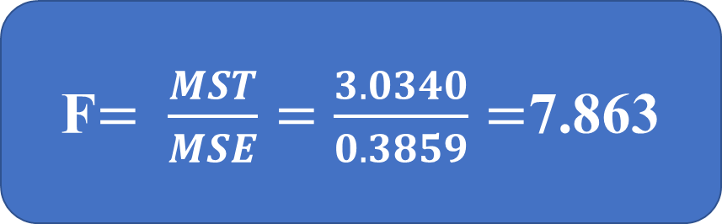
F-TEST:
F-TEST STATISTIC:
F test statistic is the ratio of two sample variances
The MST and MSE are two sample variances and that’s what we divide to find F-test value.
F$= \frac{MST}{MSE}=\frac{3.0340}{0.3859}=$7.863

Slide 14
OVERALL:
BASIC ONE-WAY ANOVA TABLE:
Source of Variation | Sum of Squares | Degrees of Freedom | Mean Square | F
Factor (Between) | SSF | k-1 | MSF= SSF/k-1 | MSF/MSE
Error (Within) | SSE | n-k | MSE= SSE/n-k
Total | SST | n-1

Slide 15
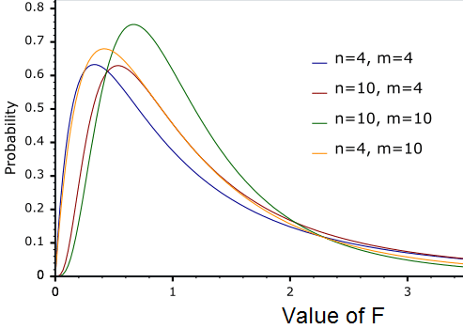
F DISTRIBUTIONS
The F test is a right (upper) tail test
The F test statistic has an F distribution with numerator degree of freedom and denominator degree of freedom
The p-value is the area to the right of the test statistic
Let’s learn how to use F-table ➔

Slide 16
AND NOW . . .
TIME TO PRACTICE!

